Slide 1

Mobile cloud computing
Submitted to: Submitted by:
Professor C. Huang Xiaolong Zhao (100952572)
Gagandeep Singh (100952914)

Slide 2
Outline
Introduction
What is Mobile Cloud Computing
Issues
Solutions
Cloudlet
Manet
Comparison between Cloudlet and Manet
Conclusion

Slide 3
Introduction
Mobile devices become an essential part of human life
Allow user to run powerful applications
Mobile users accumulate rich experience of various services from mobile applications (e.g., iPhone apps and Google apps)
However, the mobile devices are facing many challenges

Slide 4
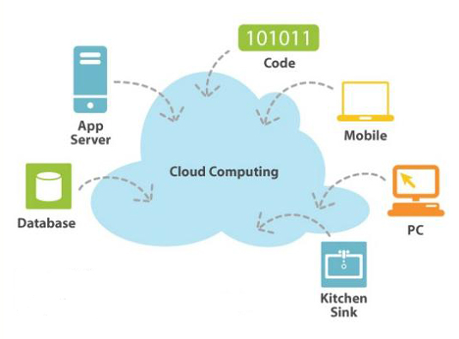
Cloud Computing

Slide 5
Mobile Cloud Computing
Mobile Cloud
Computing
Mobile network
      +
Cloud computing
MCC (Mobile Cloud Computing) enable execution of rich mobile applications on mobile devices
In MCC, mobile devices do not need a powerful configuration

Slide 6
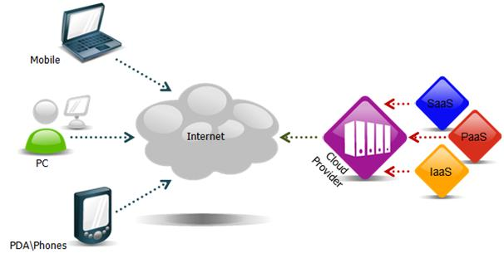
Continued..
Platform as a Service (PaaS):
  In this layer user can build, test and deploy custom applications.
  User has control over the application hosting environment configurations
  For Ex: Google app engine
Infrastructure as a Service (IaaS):
  In this layer, capability of processing, storage and networking is provided to user
  User pays on a per-use basis
  Infrastructure can be expanded or shrunk
  For Ex: Amazon Elastic Cloud Computing and Simple Storage Service (S3).
Software as a Service (SaaS):
  In this layer, the users can access an application and information remotely via the Internet
  It also allow user to share files and folders
  User cannot manage or control the underlying cloud infrastructure
  For example: Microsoft’s Live Mesh

Slide 7
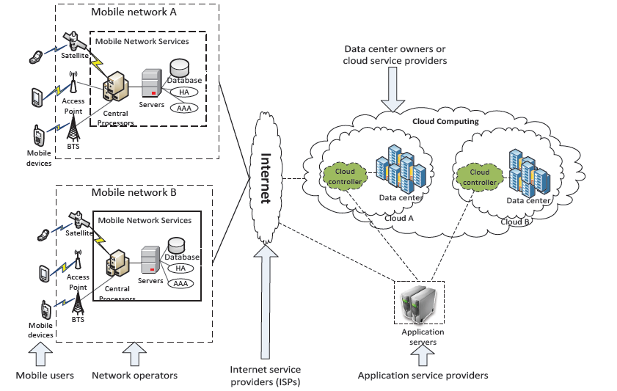
architecture

Slide 8
advantages
Extending battery lifetime
Improving data storage capacity
Improving Reliability
Security
Scalability
Easy of Integration

Slide 9
applications
Mobile commerce (m-commerce)
  M-commerce commerce using mobile devices
  M-commerce mobile banking, mobile shopping, mobile ticketing
  Challenges in traditional m-commerce low network bandwidth, high complexity and security
  Solution m-commerce Cloud computing
  Cloud computing increase data processing speed and security

Slide 10
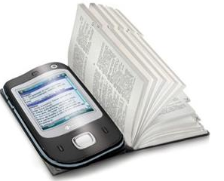
applications
Mobile learning (m-learning)
  M-learning electronic learning + mobility
  Limitations in traditional m-learning high cost of device and network, low network transmission rate and limited educational resources
  Solution M-learning Cloud computing
  Cloud computing large storage capacity, powerful processing ability and longer battery life and increase communication quality

Slide 11

applications
Mobile health care
  The health care facilities can be provided to mobile users
  First aid techniques and hospital information
  Health-aware mobile devices

Slide 12

applications
Mobile entertainment
  Services such as mobile gaming, video streaming, data storage are greatly improved
  Graphic rich games can be played on any device
  Users are able to use many real time applications, such as GPS.

Slide 13
applications
Searching Services
  Keyword-based searching
    An application to perform data searching task for mobile users
    Searching tasks will be performed on the servers in a cloud
  Voice –based searching
    Search service via speech recognition
    It utilize web-service and cloud computing environment

Slide 14
issues
Bandwidth
  The mobile technology assumes a shared bandwidth capacity
  The greater number of users will result in even lesser bandwidth availability to each user
  Methods to overcome bandwidth limitation:
    Cloud servers for online storage of data
    Html5 for offline storage

Slide 15
low bandwidth solution
Cloud Server
  Cloud servers are actually software over the internet
  These can be launched or discarded at any moment, on demand basis
  Cloud servers are dynamic in nature
  Advantages of cloud servers are:
    Signal is restored very quickly
    Data back up
    No investment needed for hardware deployment

Slide 16
low bandwidth solution
HTML 5
  HTML5 can be used for its data caching technique to improve the bandwidth utilization in mobile cloud computing.
  There are basically two capabilities in HTML5
    Application Caching: involves saving the application's core logic and user-interface
    Offline-Storage: is about capturing specific data generated by the user, or resources the user has expressed interest in

Slide 17
issues
Security
  By increase in number of devices, Security issues are also increasing.
  In Mobile cloud computing, it is necessary to protect user privacy and data secrecy.
  The security related issues in MCC are introduced in two categories:
    Security for mobile users
    Securing data on cloud

Slide 18
security
Security for mobile users
  Mobile devices like cellular phone, Smartphones, need security against virus, worm and malicious code
  And also against unauthorized users
Solutions to overcome this issue are:
  Security for mobile application
    Installing and running security software’s such as kaspersky, AVG etc
    Due to limitations in mobile devices, we move these software to cloud platform
    This platform consists of the Mobile agent and Network Service components

Slide 19
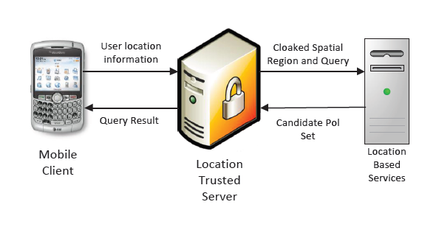
Solutions to overcome security issue
2. Privacy
Usage of Location based services (LBS) increases
The LBS faces a privacy issue
To overcome this issue Location Trusted Server (LTS) is introduced.
Firstly, the mobile user send request to LTS
Then, LTS convert information into ‘Cloked Region’
Then the ‘cloaked region’ is sent to LBS
But still there is a problem if LTS disclose user’s information
Now, we generate the “Cloaked region” on mobile devices
Therefore both LTS and LBS cannot know the sender’s information

Slide 20
security
Security on cloud
  While storing data on cloud, we should be careful in term of data integrity and authentication
  Data related issues in MCC are:
    Integrity
      Scheme performs three phases: the initialization, the update and the verification
      Initialization phase: the file(F) will be assigned with authentication code (FC)
      Code(FC) will be saved in mobile device and file(F) on cloud
    Verification phase: client can request the integrity verification of a file, collection of files, or the whole file system stored in the cloud
    checking and verification are processed on TCC on cloud and client only compares a code.
      Update phase: The cloud sends file (F) to the user and parallely send a message to Trusted crypto coprocessor (TCC) to generate code (FC)
      Then TCC sends (FC) to mobile user to verify the file (F) by comparing it with code (FC) i.e. stored in the mobile itself
      If both codes match with each other, then user can change or modify the file.

Slide 21
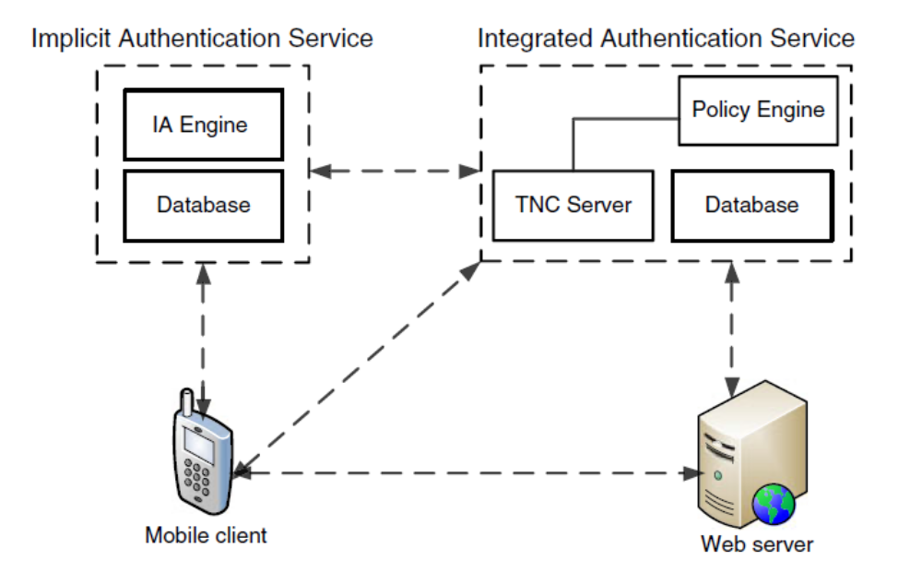
Security on cloud
Authentication

Slide 22
ISSUE of SERVICE AVAILABILITY
Applications in the cloud server should be accessible, computable and available without any delay.
Service availability deals with the aspect that an un-interrupted flow and access between the user and the cloud remains intact.
It is important as day-by-day a rapid increase in the number of mobile users is increasing , addressing the mobile service providers to give a distraction less network coverage.

Slide 23
HANDOVER LATENCY
HANDOVER
The task of maintaining an un-interrupted connectivity when a mobile device changes to different network.
HANDOVER LATENCY
The time instance in the mobile connectivity when the mobile node is unable to transmit and receive packets.

Slide 24
MOBILE IPv6 [ fast handovers]
FMIPv6 is introduced to reduce handover latency and reduction in data packet loss during network change.
It works on the basis of two schemes and message interchange-indication mechanism
- Predictive mode
- Reactive mode

Slide 25
The CLOUDLET approach
An efficient gateway between the mobile device and the CLOUD working on the basis of VIRTUAL MACHINE (VM) environment.
MOBILE DEVICE - CLOUDLET – CLOUD
A network of CLOUDLET are resourceful systems giving access to the incoming mobile devices to use and compute the information from the end CLOUD.

Slide 26
Cloudlet is the soft state which contains cached state of databases from clouds which is managed by its own.
Gets well-connected to the cloud and hence provides better connectivity to the mobile user as several systems combine getting more processing power and computation power.
Bandwidth issue arises as Cloudlet has less bandwidth as connected to LAN whereas Cloud has high bandwidth

Slide 27
MOBILE AD-HOC NETWORK (wi-fi MANET)
A self-configuring infrastructless network of mobile devices connected through wireless links with the help of wi-fi LANs.
Device in the MANET network is free to move and gets linked to other devices frequently
Devices in MANET forward traffic unrelated to them as they work as routers or service nodes.
Networks operate by themselves and can also be connected with internet.

Slide 28
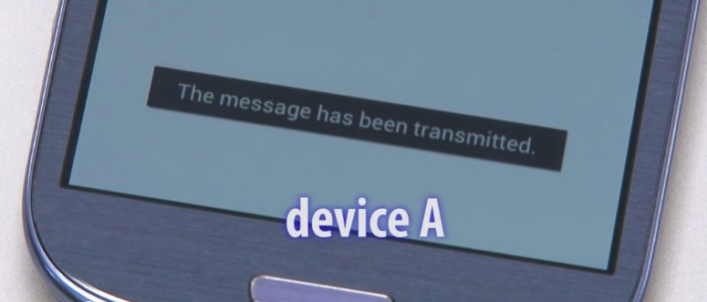
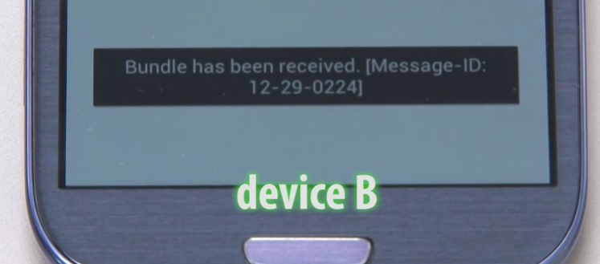
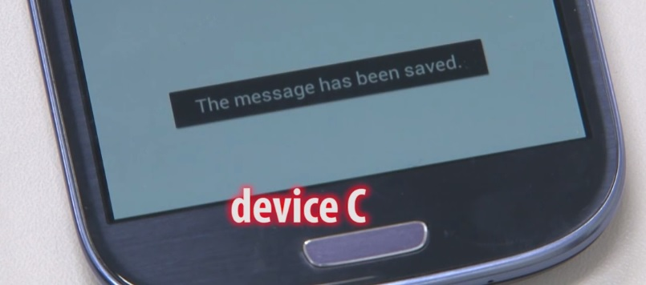
For source and destination nodes, not being in communication range or experiencing delay in transmission, data is forwarded to the destination through intermediate nodes.

Slide 29
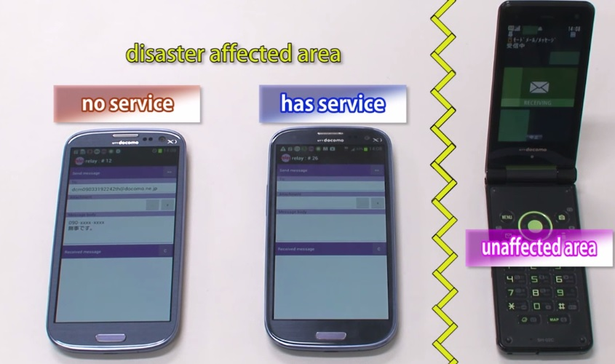

Slide 30
Modes of Wifi MANET
Proactive routing scheme
Nodes are on updation mode keeping track of all the routes of mobile service nodes.
Minimal delay and more bandwidth
DSDV (Destination-sequenced distance vector protocol)
Reactive routing scheme
Nodes only finds route to destination on-demand when transmission is needed.
Higher delay and Less
DSR (Dynamic Source routing)
AODV- Ad Hoc on demand Vector Protocol

Slide 31
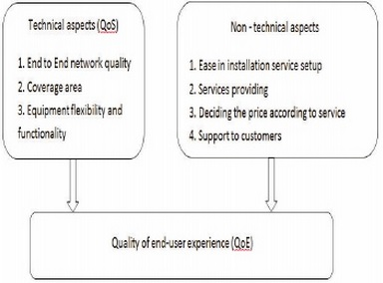
Quality Of Experience
Efforts employed by the service provider to give user the best of services determining the QoS.
The user thus aggregates the QoE on the basis of certain aspects like
- service availability.
- cost.
- data transfer speeds.

Slide 32
Conclusion
An overview of certain issues and their solutions have been discussed which direct us to improve the Mobile Cloud Computing concept.
Basic working architecture and techniques such as Cloudservers and MANET have been introduced which clears the basis of MCC.
Presented study directs us to have more efficient approaches towards customer satisfaction, data security, cost, service availability and more over to have various MMC applications.

Slide 33
References
A STUDY ON MOBILE AD-HOCK NETWORKS (MANETS) by
P. Senthilkumar, M. Baskar and K. Saravanan1Assistant professor, MCA, Coimbatore Institute of Management and Technology, Tamilnadu.2 IIIrd MCA, Coimbatore Institute of Management and Technology, Tamilnadu.
An Analysis of the Handover Latency Components in Mobile IPv6 of Internet Engineering , by Vasos Vassiliou and Zinon Zinonos (JOURNAL OF INTERNET ENGINEERING, VOL. 3, NO. 1, DECEMBER 2009)
The Role of Cloudlets in hostile Environments , Mahadev Satyanarayanan, Carnegie Mellon University, Grace Lewis, Edwin Morris, Soumya Simanta, and Jeff Boleng Software Engineering Institute ,Kiryong Ha,Carnegie Mellon University. Published by the IEEE CS.
Mobile Ad Hoc Networking: Imperatives and Challenges byPravin Ghosekar HOD, Computer Department Dhanwate National College Nagpur, India . Girish Katkar ,HOD, Dept. of Computer Sci. ACS College Koradi Dist. Nagpur (MS) India Dr. Pradip Ghorpade Shivaji Mahavidyalaya Gadchiroli (MS) India

